Slide 1
Roadmap Plans
31/08/2017

Slide 2
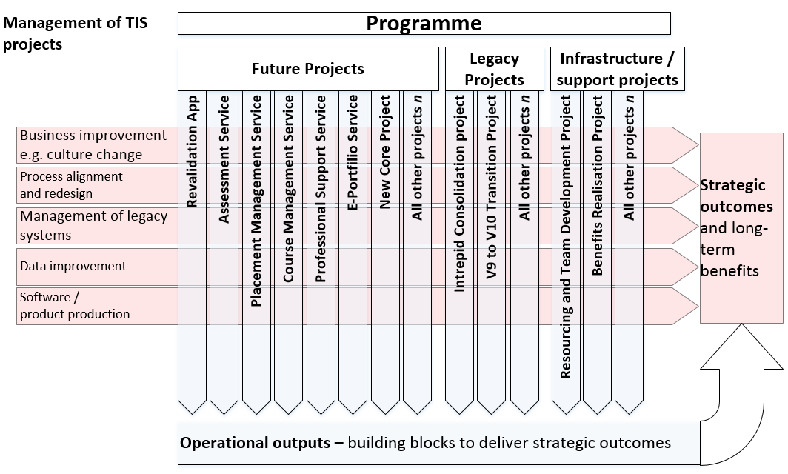
Project management approach
This illustrates how projects fit within the Strategic outcomes of the programme. Each project contributes the overall strategic success of the programme.

Slide 3
Planning levels
For the purpose of the TIS programme, planning is defined as follows:
Plan level | Plan type | Audience
Level 1 | Roadmap – “a plan on a page” showing major and key deliverables and helps describe what the programme is. | SRO, Board and wider organisation
Level 2 | Programme Plan – All major activities and deliverables with dependencies between (not within) projects and between the programme and other HEE programmes. | SRO, Board, programme team and senior organisation
Level 3 | Project plans – Details the precise activities to produce the outputs within the duration of the project. Dependencies are task-level within and between projects. | Project managers and teams
Level 4 | Sprint-level plans – These detail the “story-driven” deliverables within the sprint cycles that are usually two weeks. | Internal to the development teams and linked operational staff

Slide 4
Road map – Indicative plan for product development (TCS)
Jun
July
Aug
Sep
Oct
Nov
Dec
Jan
Feb
Mar
Apr
May
Sprint
39
3426
40
28
35
36
37
41
43
44
48
49
2726
29
3026
33
42
45
46
47
50
51
n
26
3126
3226
38
F03 – TIS Core Services
Variety of outputs + those detailed below
Phase 1
F01 – Revalidation service
Live transition
Normal BAU optimisation
F11 – Programme + Curr
Dev
Iteration and optimisation
F12 – Post management
Dev
F08 – Trainee UI
Dev
F16 – People management
Dev
F04 – Placements & rot
Research
Dev
F02 – Assessment
Dev
Phase 2
F17 – Trust UI
Process of live transition TBD
F13 – Finance management
F09 – Trainer UI
Phase 3
F15 – Absence management
Sequence and start of development TBA
F14 – Approvals
F06 – Case management
F05 – Course and event
F20 – Reporting + analytics
Throughout
F10 – Quality management
Not in Intrepid
Iterative + optimisation
Research Intrepid equivalence

