Slide 1
Lunch and learn:
A dive into Scrum theory to get us all onto the same page
But before we begin, an overview of Agile – the concept that underpins the Scrum Framework
Notes:
Scrum and Agile are inextricably linked.
I’d go so far as to say you can’t do Scrum without ‘being’ Agile
You can ‘be’ Agile and not do Scrum!

Slide 2
Notes:
Agile concepts have been around since the 50s. Codified in the Manifesto in 2001.
Scrum came together as a term in the late 80s. Codified in a paper at OOPSLA.
Adapted from Visual Paradigm
Notes:
Codification has happened only relatively recently, but the ideas have been around much longer.
Codification has largely been stimulated by the adoption of Agile | Scrum in software development

Slide 3
Project management is a spectrum
Hierarchical control
Team self-organisation
Waterfall (e.g. Prince2)
Heavy on documentation of requirements and estimates and following a plan. Not known for handling change well
Agile (e.g. DSDM) Heavy initial focus on documentation at the beginning
Agile (e.g. Scrum) A lightweight, simple to understand framework giving a balance of transparency and ability to engage customers and stakeholders
Agile (e.g. Kanban)
Focus on process-light / limiting WIP – great for developers, not so easy for non-Agile stakeholders to visualise what’s coming up
Control model | Shades of grey in the middle | Agile model
Used commonly in digital agencies needing to attribute cost to clients. Or civil/public services with entrenched hierarchical management structures | A sliding left to right scale of increasing desire to engage directly with customers rather than just stakeholders as early and as often in the development process as possible | Commonly used where overwhelming focus is on creating and realising value for the customer
Devs time is allocated hour by hour. Direct contact with clients is strictly limited. Dev functions are cascaded in a sequence of functional hand-offs | A sliding left to right scale of levels of hierarchical control vs development team self-organisation and empowerment | Devs are self-managing. Constantly testing and learning from direct contact with the customer
Notes:
Size of organisation
Organisation’s appetite for change
Size of team
That team’s appetite for using a different approach to what it is used to
Nature of the project being worked on (though Scrum is used across the board now on projects that typically one might think would be more natural candidates for a waterfall approach)
==================================================================
Below is a fictitious scenario that describes well, why I like Scrum as my default approach to everything. It provides a framework for how humans intelligently think anyway, not a methodology that has to be learned and followed. It is therefore as flexible as the human creativity of the team practicing it:
Imagine you’re air-dropped into the Canadian wilderness in the middle of winter with 12 huskies, 12 tethers, a sled and the knowledge that you have to get to the nearest town by a certain day or you’ll probably die of exposure (you’re given the team you have to work with, a new project you need to complete and a deadline). What do you do?
Waterfall:
Spend a LOT of precious time planning and documenting at the start (thinking about where the nearest town is, how to get there, how long it will take, what I will need to take with me… and slowly freezing, running out of time to assemble your husky team, find the nearest town, and ultimately survive!
Once a plan is in place, you set off.
Shortly, you tire, get hungry and stop to rest and eat. You realise that you get tired and hungry more quickly in this environment, and start to regret spending so much time planning, when you could have used your energy getting to your destination. You set off again and resolve to keep going with as little rest and food as possible in order to maximise your travel time.
You don’t notice that a tether to one of the huskies is coming loose. You are now full steam ahead and can’t waste time on stopping and testing anything at this point.
One husky breaks away from the team as its tether separates. You plough on regardless – you have that deadline to meet.
Several more break loose. You realise you didn’t know how to tie the best kind of knot for this job. You carry on anyway – you must be nearly there now.
All your huskies are now loose from your sled. You are still nowhere near the town. You use your emergency Sat phone to call in for more huskies, extra food, or just to call a helicopter!
Agile | Scrum:
Challenge any initial assumptions made - Appreciate whether the deadline is movable! Will you die if you miss it? - Check dogs, tethers, equipment, rations etc - Scan for any sign of habitation closer than the town you have been told to head for
Understand your vision and objectives - Is it just getting to the nearest town and fundamental survival? Or could it be about thriving in the environment, rendering the deadline irrelevant? Is it a proof of concept to test for a new Outward Bound product where others will be dropped in the wilderness in the same way? Do the huskies need to survive?
Sketch out the main requirements to meet each objective. Estimate the balance between effort and value in order to prioritise. Leave a note (in case you get lost/don’t make it, and the search party find the note, they’ll have something to go on to either find you, or adjust the project, for the next attempt).
Get started on the highest priority tasks: wrap up warm, gather your stuff on the sled, secure it, tether the huskies to the sled, test the tethers, see whether you’re already on a well-worn path/road, determine a direction of travel (in the absence of anything to inform, it doesn’t actually matter which direction you take), begin. After a period of time, review progress. Adjust any of the above variables accordingly. If you learn something: you’re not warm enough, put on more clothes; the huskies are slowing down, reduce your pace, but rotate a couple of huskies off the team to keep the team fresh between stops; the tethers are coming loose (test using a different knot); you’re definitely heading in the wrong direction, change direction! Leave a note for the search team. Inspect. Adapt. Be transparent.

Slide 4
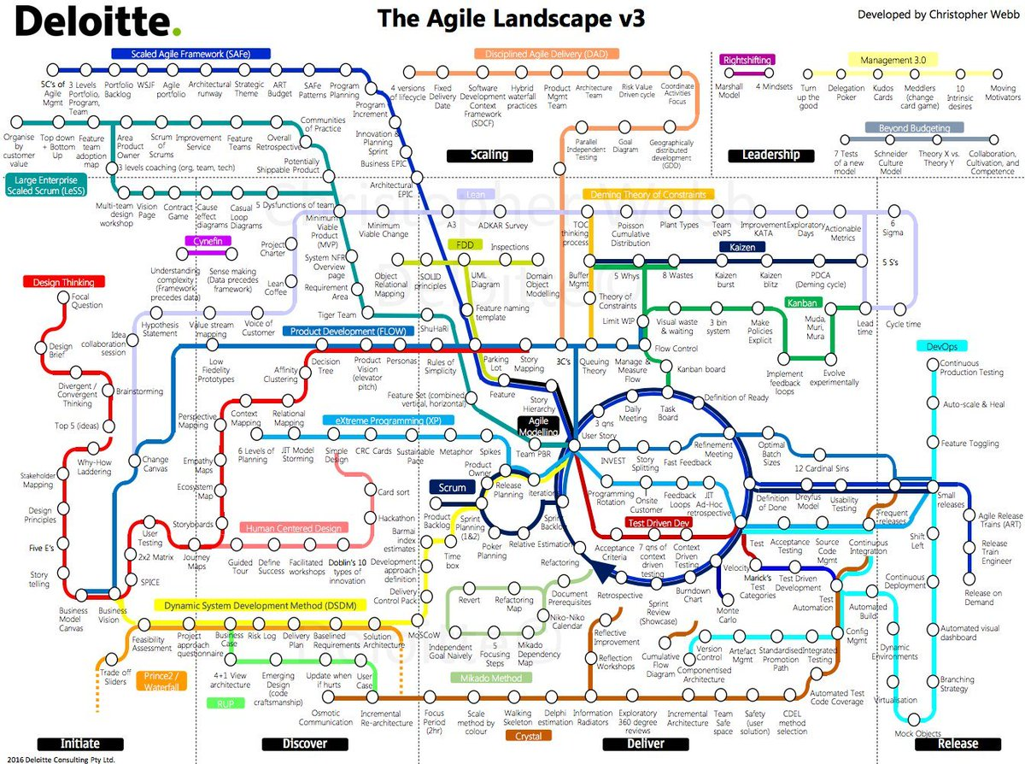
Notes:
The Agile mindset, and frameworks and methodologies supporting that mindset have proliferated through every element of the SDLC

Slide 5
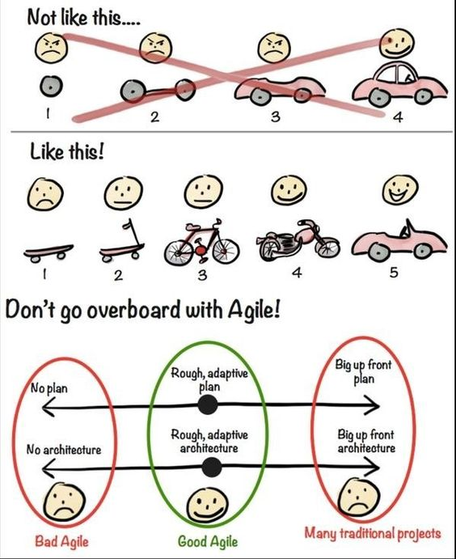
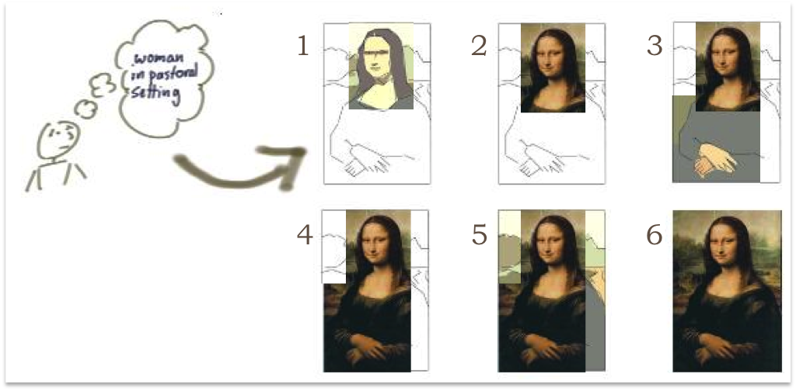
It’s very easy to plan too much - to get too much of an idea as to what the end product looks like, and to increment towards that. That’s not Agile.
Agile is about adaptation. It’s about listening to customer feedback. It’s about preparing to build (and throw away) rapidly developed proofs of concept.
Also, it’s not about having no plan at all. It’s not about no documentation at all. It’s about ‘just enough’ of each.
With too clear a plan at the start, you risk only building to the plan, incrementally. Each increment is rarely going to give a customer much of use until the final increment is deployed.
With an iterative approach and an idea of direction of travel to an end point, you sketch, and each sketch provides the customer with a view of the fuller picture – giving more context to the iteration.
In reality, Scrum usually combines the two – allowing adaptation, giving a view of the bigger picture and presenting a degree of detail for smaller elements as we go as well
Credit: Jeff Patton
Credit: Henrik Kniberg
Notes:
We have been conditioned to think waterfall, but fundamentally humans are natural Agile thinkers.
Occasionally, we need to step out of our conditioning to make Agile work best.

Slide 6
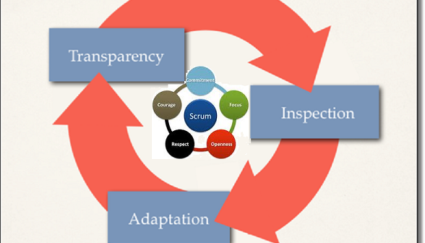
So what’s the difference between Agile and Scrum?
‘Agile’ is more a mindset than a project management methodology.
It’s a set of behaviours. An outlook on how you approach work. It is a team contract.
Scrum is a project management framework that attempts to put the Agile mindset to work in a way that brakes the mould of previous traditional waterfall methods. Focusing on three things:
Inspection: from the whole team on everything they do and everything the customer feeds back to them, in order to learn and engage with their customer;
Adaptation: continuous improvement, making iterative improvements and releasing the product incrementally to the customer; and
Transparency: people only make good decisions when they have all pertinent information at their disposal. Transparency requires trust from all parties.
Credit: Larion
Notes:
Agile is a way of thinking and working within a team environment
Scrum is a framework for the process of using Agile to complete a project

Slide 7
Scrum is simple! It’s literally a one-pager!
3 roles
Product Owner: management of the backlog
Scrum Master: coordination of the team
The development team: self-organises to deliver a potentially shippable product increment at the end of each Sprint
5 events
The Sprint: 1-4 week period for the team to timebox development of deployable work
Sprint Planning: meeting for the team to commit to work
Daily scrum (stand up): 15 min synchronisation meeting for the team to share progress, ask for help, highlight impediments and highlight where collaboration between specific team members would be beneficial. A 24-hour inspect and adapt meeting
Sprint Review: meeting to inspect the work ‘done’ during the Sprint with stakeholders with the desire to get their feedback on it, and their steer on future product direction
Sprint Retrospective: meeting for the team to introspect and adapt their ways of working in order to make future Sprints more effective
3 artifacts
Product backlog: everything currently known that the team might eventually work on
Sprint backlog: everything the team will work on in the next 2 (in our case) weeks
Increment: a potentially shippable product increment – “a body of inspectable, done work that supports empiricism at the end of the Sprint”.
Notes:
Despite it being simple, it is very difficult to master. And it has some limitations:
Works best when the team have a shared understanding of how it works
Despite its simplicity, grooming of the backlog takes time and requires not just the POs, but Devs too (and Devs often perceive this as a waste of theirs!)
Works best when stakeholders in an organisation are also familiar with it
Works best when the team is 5-9 people – the codification of scaling Scrum has only really been attempted from around 2007 (SAFe)

Slide 8
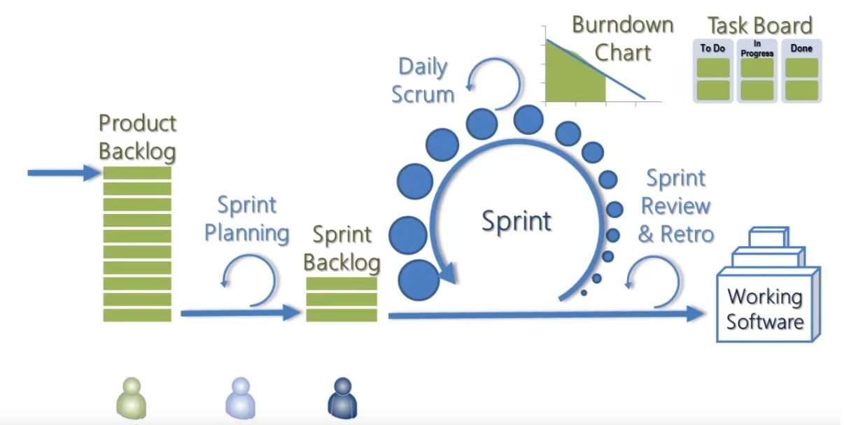
Credit: Neuron Technology

Slide 9
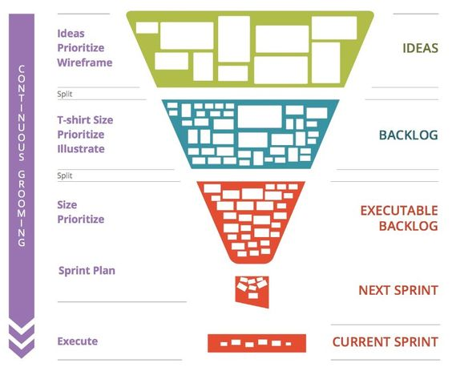
Credit: Pinterest

Slide 10
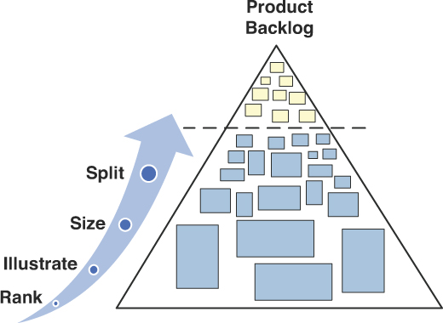
Credit: Pearson Education

Slide 11
Scrum in practice / Evolution of Scrum into DevOps
Effectiveness and Efficiency Being effective is about doing the right things, while being efficient is about doing things right So you can be effective and have room to be more efficient (doing the right things badly). Similarly, you can be efficient, but ineffective (doing the wrong things really well!). Scrum gives visibility such that it increases the likelihood of being effective and the nature of the framework encourages efficiency as well.
Release trains → Continuous integration / continuous deployment One deployment per Sprint, one deployment per release (potentially multiple Sprints)? Or deployment of every micro piece of code, by Devs themselves, from their local machines, automatically tested through Dev and Stage through to the Prod environment many multiple times per day?
E.g. Amazon do a release every …………………
second!! (c.50 million annually [as of an article from 2015]) The ‘pipeline’ our Ops guys are currently working on are moving us in this direction
Reduce need for Scrum structures / Scrum Master role / DevOps role! With CI/CD user Bug management (BAU), and new feature requests becomes the focus for the team (development based on empirical feedback), rather than projects based on what internal stakeholders believe the customer wants (and because of the inherent assumptions baked into this approach, can easily culminate in wasted effort on non-valuable code)

Slide 12
Further reading:
The Scrum Guide: https://www.scrumguides.org/docs/scrumguide/v2017/2017-Scrum-Guide-US.pdf
CI/CD/CD: https://www.atlassian.com/continuous-delivery/ci-vs-ci-vs-cd
DevOps: https://www.atlassian.com/devops
‘How Scrum works’ videos:
A bit noddy (5mins): https://www.youtube.com/watch?v=2Vt7Ik8Ublw
Quite clever (10 mins): https://www.youtube.com/watch?v=RaaBrPCo_Mw [but references Demo instead of Sprint Review, Scrum leader rather than Scrum Master, weirdly!]

